Slide 1
Choosing the right data stack
Database vs.
Data warehouse vs.
Datalake

Slide 2




About Me
Dinesh Kumar P
Product Manager,
Analytics Squad.
https://www.linkedin.com/in/dinesh-kumar-prabakaran
Notes:
Myself currently working as a product manager, for the analytics and reports squad at Kissflow. Coming through 8+ years of the journey around data space, I have involved in implementing B2B SaaS products for Big Data, ETL, and Business Intelligence.

Slide 3

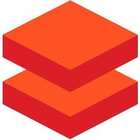
Agenda
1. Core architecture and scenarios of having Database, Data warehouse, Data Lake.
2. Azure Synapse Analytics, Azure Databricks.
3. Common features but different in Synapse and Databricks of Azure.
4. When to use Azure Synapse, Azure Databricks?
5. Cloud data warehouse era.
6. Snowflake on Azure.
7. Data use cases at
8. What’s next? Data Lakehouse.
Notes:
Wont be covering about each topic in detail. The aim of my talk is to share my knowledge about understanding the difference between tech stack, which look almost same in terms of features. And I expect that audience would know a little bit of basics like what is a Database, Data warehouse and so.

Slide 4

For what basic skill, different people get different salaries?
$10,000
$5000
$1000
$500
$50
Notes:
Let me ask a simple question. For what basic skill, different people get different salary? Perhaps that is the same basic thing which all the ML or AI projects are solving and make our life easier.

Slide 5
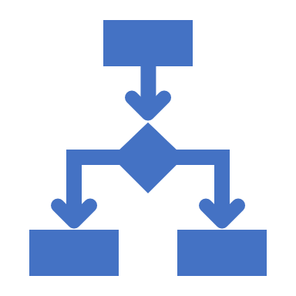


Decision Making
Notes:
Its DECISION MAKING.

Slide 6
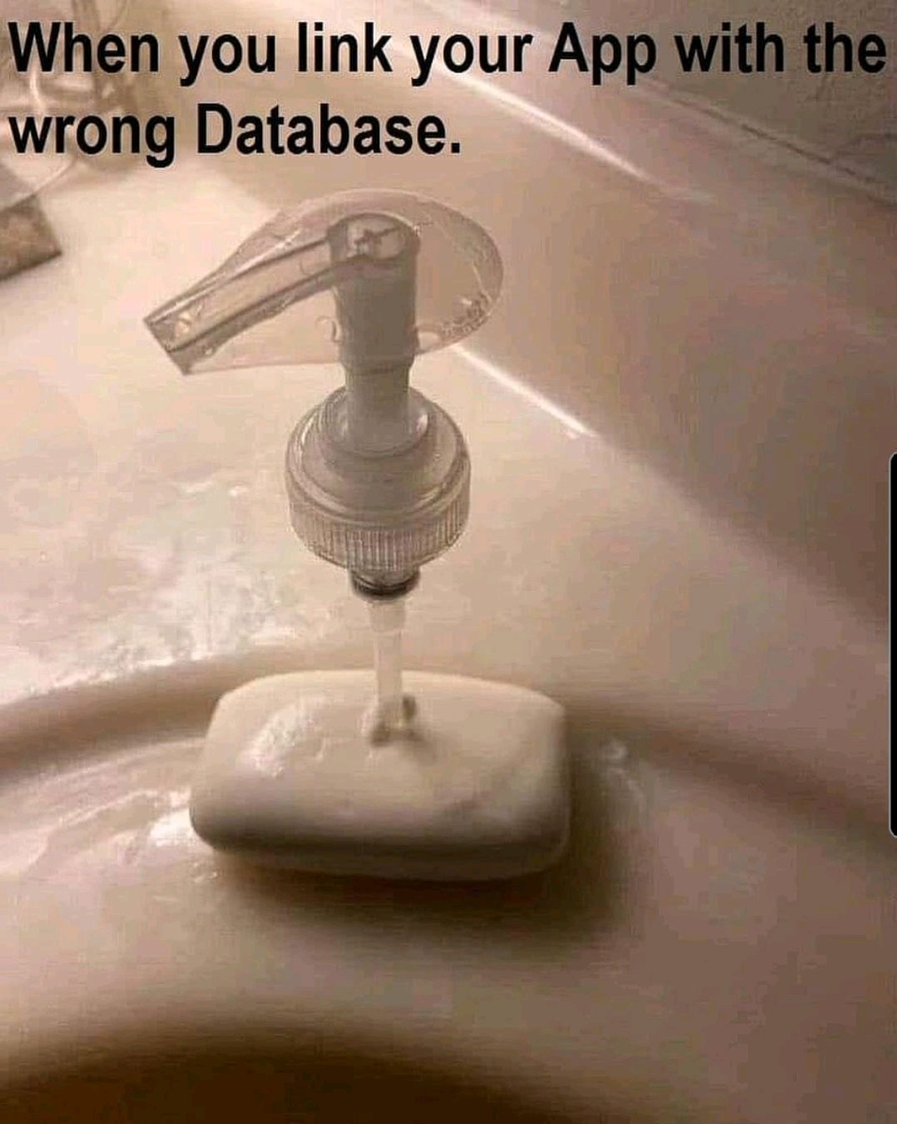
Before beginning…
* Don’t choose a data tech, just because you / your team knew it.
* Lets see how to choose right database for your need.

Slide 7
Database Data warehouse Data Lake
- Demystify.
- Best fit scenarios to choose.
Notes:
This is a crazy and slightly confusing time in the data architecture space. More and more companies are shifting towards data lakes, yet the traditional data warehouse and database continues to provide value, as it has for decades. Now to add that, we have this increasingly popular lakehouse and delta lake concept. The concepts I discuss here will be common that would fit for deciding over data services in Azure as well.

Slide 8
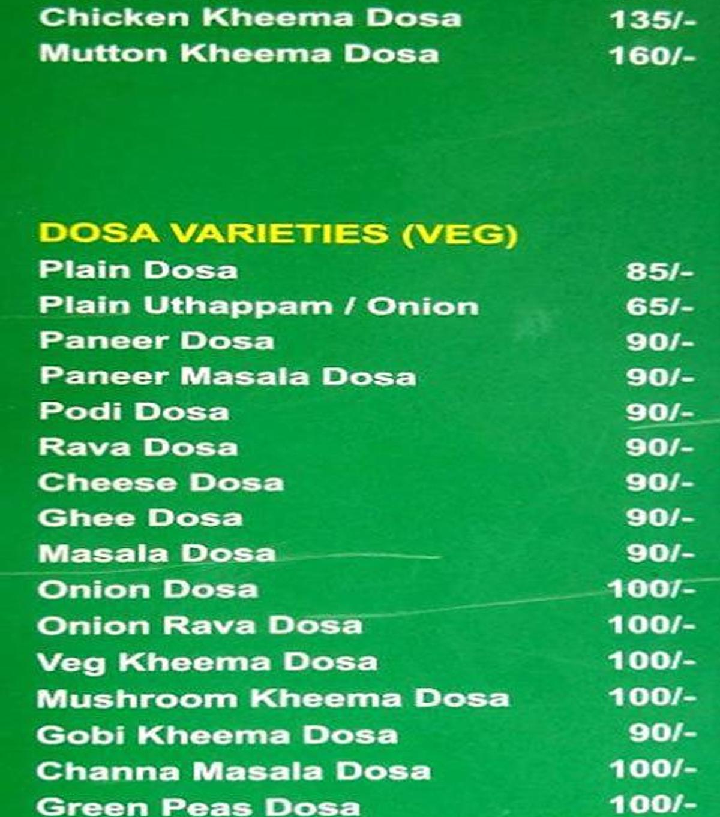
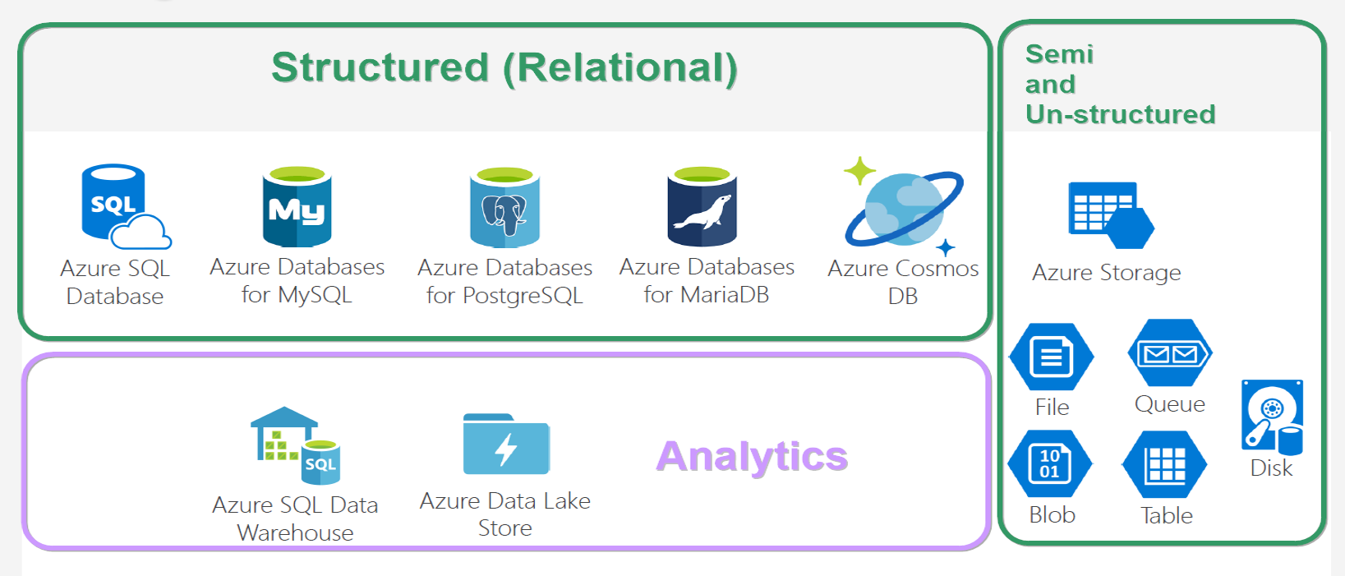
Database VARIETIES
Notes:
And looking at this, does both give same feeling? ☺

Slide 9
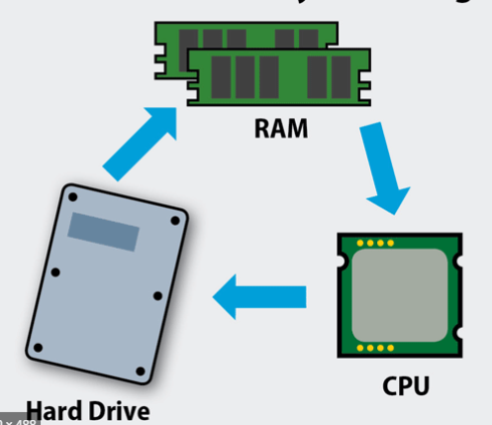
Database
* Co-location of Compute & Storage.
* Schema on Write.
* Recommended for,
- Structured data of less than a TB,
- Purpose - OLTP.
* Not recommended for,
- Ad-hoc analytics.
- More dependency in sharding.

Slide 10
DBMS storage models
Notes:
NoSQL db – data storage model types –
* Document - Frequent schema changes with sub-tables need. The document model allows you to structure data any way your application needs (Mongo DB)
* Graph – Neo4j.
* Key-value - Redis.
* Column-oriented – Hbase, Cassandra.

Slide 11
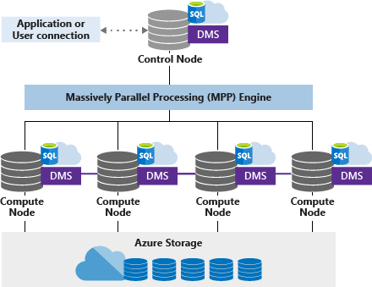
Data warehouse
* Separation of Compute & Storage. (Data copied into warehouse).
* Schema on Write.
* Recommended,
- If you know metadata & format of analytics to be done.
- ML/AI not needed much. Query not over large dataset.
- Expose out; allowing customers to analyse.
* Not recommended,
- Unstructured data like image and video.
- Semi-structured with multiple levels.

Slide 12
Data lake
* Separation of Compute & Data.
* Schema on Read.
* Recommended,
- Must store all types of data of any size.
- Query over large datasets.
- Store now; play later as and when you need. (Internal analytics).
* Not recommended,
- Data stored should be readily available for analytics upon which users would create reports.

Slide 13
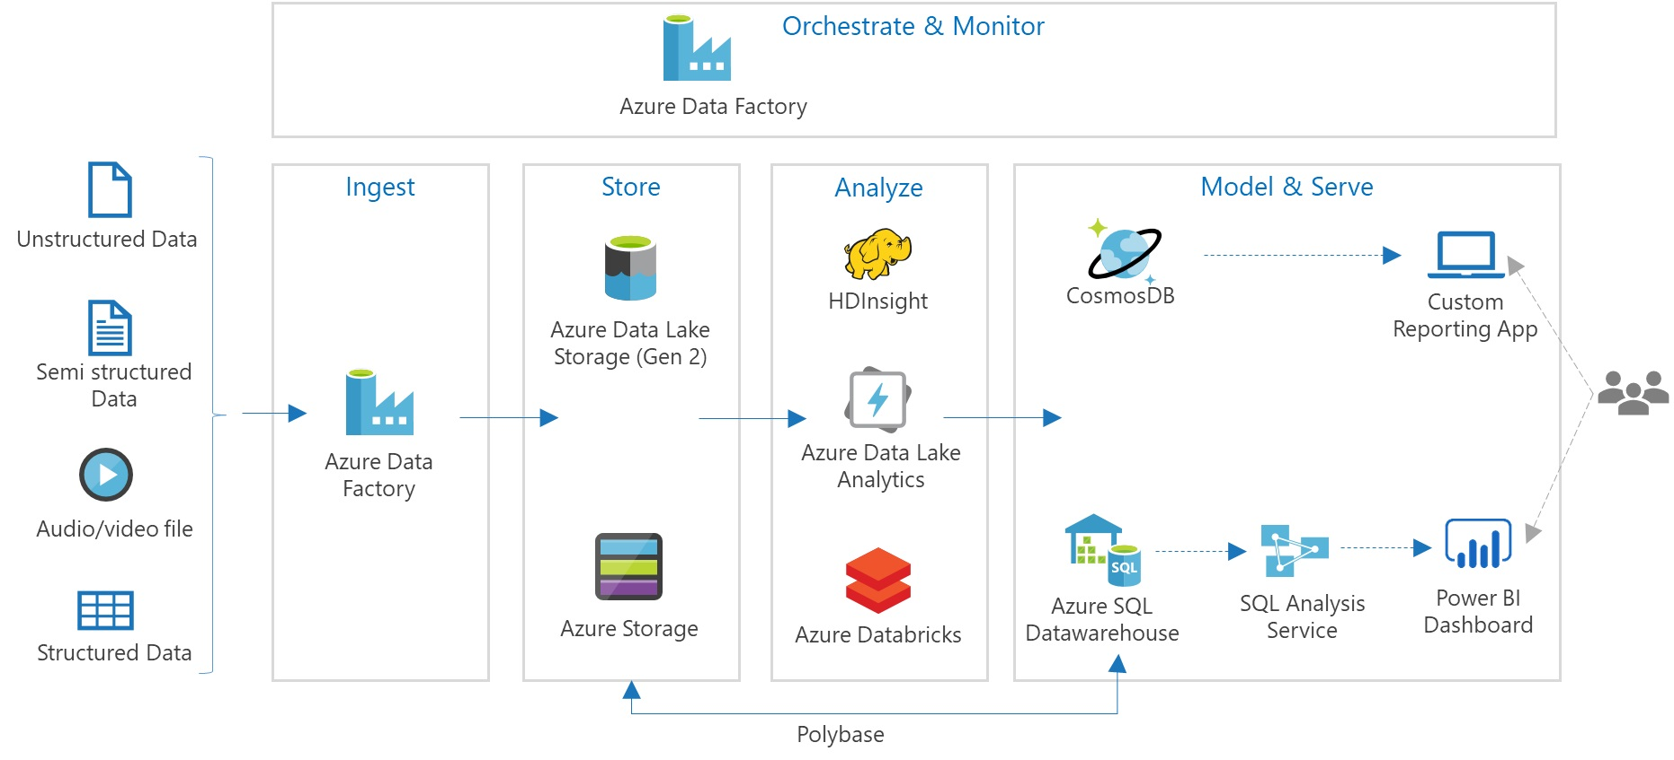
Data lake

Slide 14
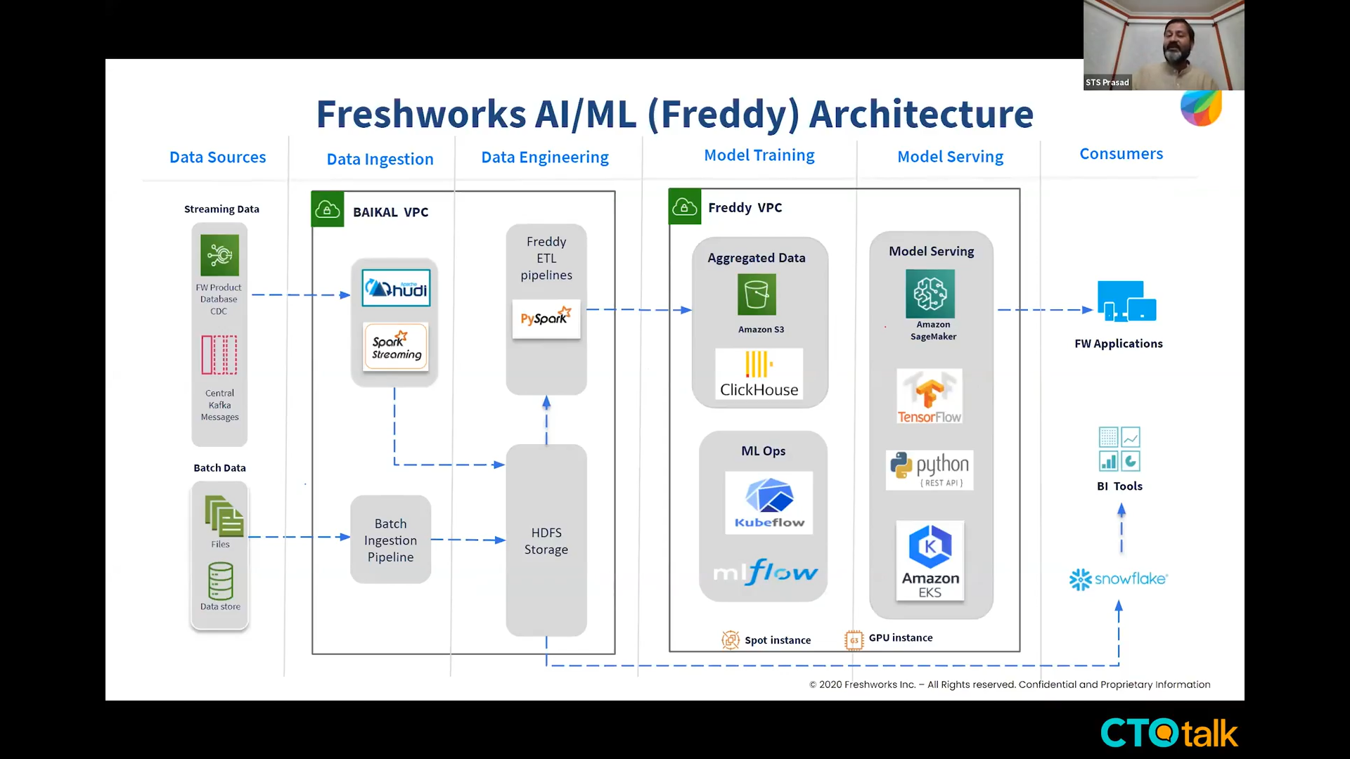
HYBRID Data architecture
Notes:
https://blog.ctotalk.in/freddy-and-the-analytics-platform-of-freshworks-by-sts-prasad-svp-freshworks-engineering-in-cto-2fbaefc204e3

Slide 15
OLTP vs OLAP
Transaction databases
Analytics databases

Slide 16
transaction db vs analytics db
Characteristic | OLTP | OLAP
Data | Operational data in row format. Both read and write – CRUD. | Historical data in column format. More Read and less rare – SELECT.
Query pattern | Small no of records fetched by a key, Simple joins. | Large no of records with aggregation columns. Complex joins with where clauses.
Users | Application developers. | Analyst, decision makers.
Providers | SQL Server, Mysql, Postgres. Azure Cloud SQL, Google Cloud Spanner, AWS RDS. | Teradata, Vertica. Synapse Analytics, Snowflake, Big Query, Redshift.

Slide 17
Use case at Kissflow

Slide 18
* SaaS product - No Code environment.
* Customers (business users) build workflow apps for their domain.
* Based on our product nature, per customer data won’t be huge.
* OLTP – MongoDB (Earlier MySQL)
* 1 database per customer. Unique schema (data model) for each customer.
* OLAP - explored data lake, database and finally we choose data warehouse.
Notes:
The Kissflow Digital Workplace is a no-code environment where anyone including business users can create an automated process, build a project board, handle a case flow, and host important discussions about work, all in one intelligent and easily integrated platform.

Slide 19
OLTP => SQL to NO-SQL
* MySQL to MongoDB.
* Scaling.
* Advantages like Sharding, Flexible schema.

Slide 20
Demo – 1
Travel reimbursement process.
To checkout when a NoSQL database make more sense for a product.

Slide 21
CLOUD data warehouse ERA
Azure Synapse Analytics
Snowflake
Amazon Redshift
Google BigQuery

Slide 22
Towards Cloud – banks and pharma

Slide 23


Slide 24
Azure Synapse Analytics Azure Databricks
What each does?
Common features but how each one is different?

Slide 25
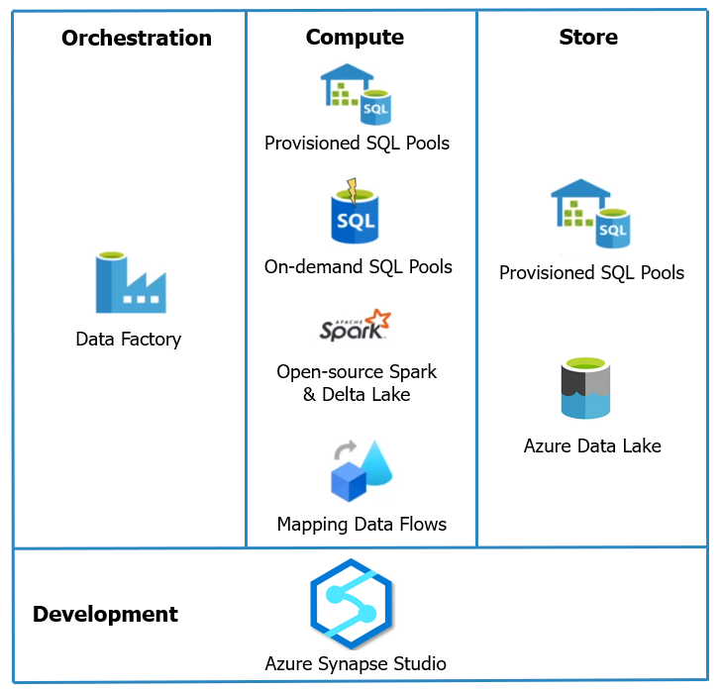
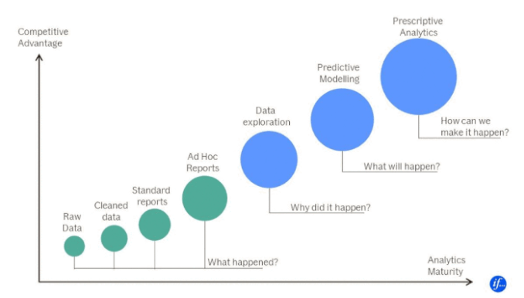
Azure Synapse Analytics
* Azure SQL Warehouse rebranded.
Notes:
* Background engineering improvised for better performance. Front end features are in beta as of now.

Slide 26
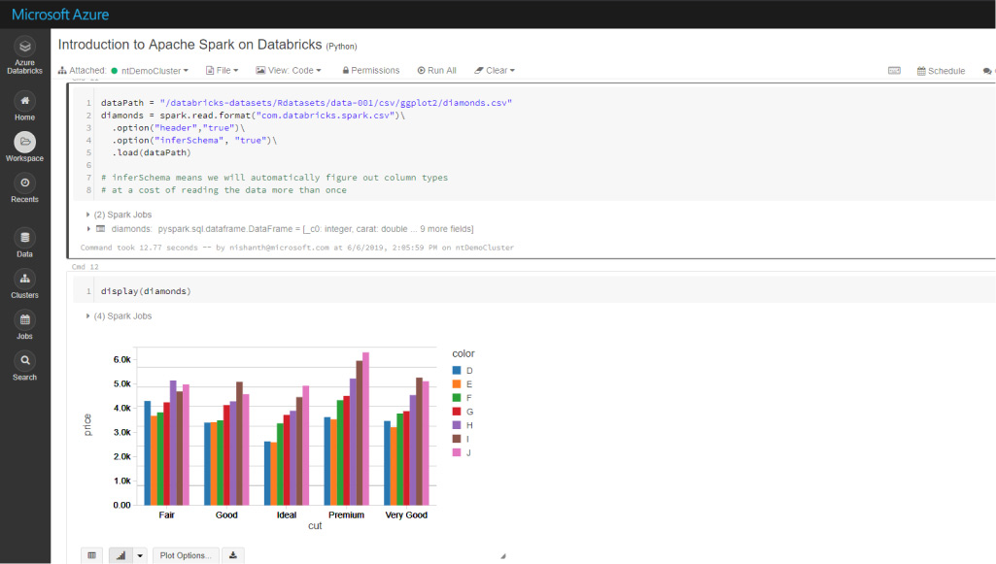
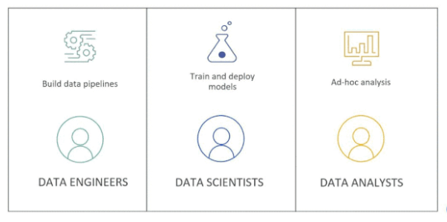
Azure databricks
* Data Lake.
* Hosted Spark environment - expanding with Delta Lake, MlFlow and SQL analytics.
* Best option for Machine Learning workloads for those with Microsoft tech stack.

Slide 27
Common but different
Common feature | Azure Synapse Analytics | Azure Databricks
Apache Spark & Delta Lake | Open-source. | Latest from Databricks.
Jupyter Notebooks | Nteract notebooks. | Databricks notebooks, real time co-authoring & automated versioning.
Access data from a Data Lake | Easier to query from sql scripts and notebooks. | Need to mount and then query.
Cloud hosted Python & SQL env | Good at Ad-hoc analysis. | Good at Mlflow.
Compute separate architecture | SQL on-demand pool. | Autoscaling pool.

Slide 28
When to use synapse and/or databricks
 | Use case / Scenario | Preferred
1 | Ad-hoc data lake discovery by code | Synapse and Databricks
2 | SQL analyses & Data warehousing | Synapse
3 | Self-service BI / Reporting | Synapse
4 | Same data, data scientists play via Spark & data analyst play via SQL. & BI use Power BI | Synapse
5 | More ML/AI development, GPU intensive tasks | Databricks
6 | Dependent tech is much on Delta lake format / Spark | Databricks
7 | In-built GIT based developer experience | Databricks
Notes:
Not going to repeat the points which I spoke earlier. I mean core features of Data warehouse / Data Lake / Data Lakehouse.

Slide 29
Kissflow analytics
OLAP
Analytics as a service

Slide 30
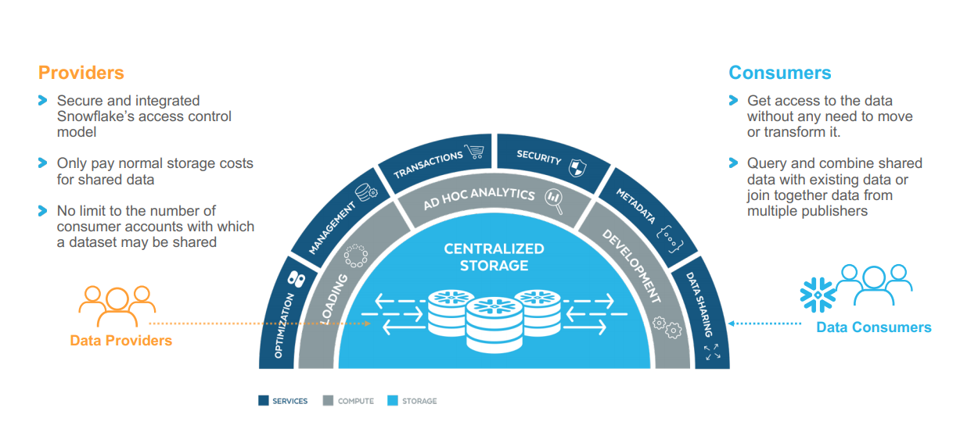
Snowflake ARCHITECTURE
Notes:
Store all your data.
Extreme simplicity.
Full support for ACID transactions with read consistency.
ANSI SQL, RBAC.

Slide 31
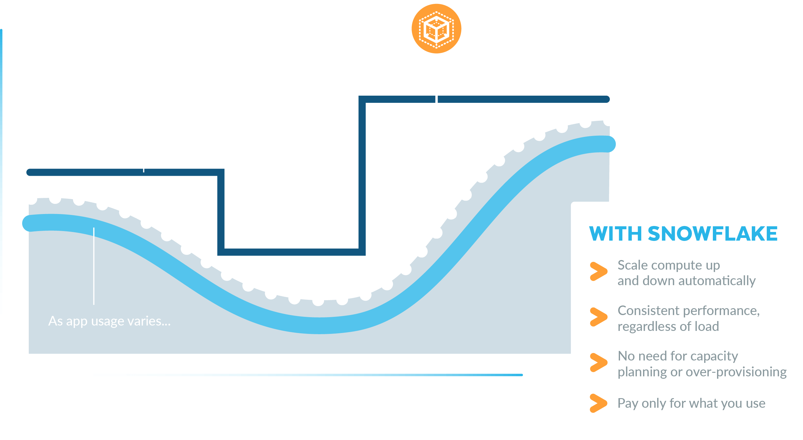
instant auto scaling

Slide 32
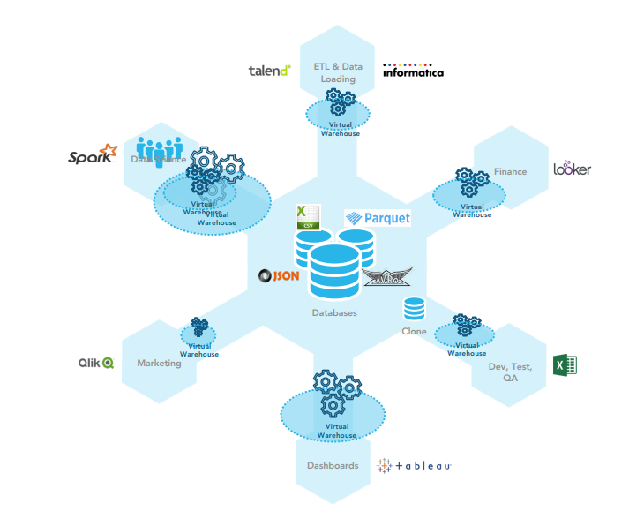
Multi-cluster shared data architecture

Slide 33
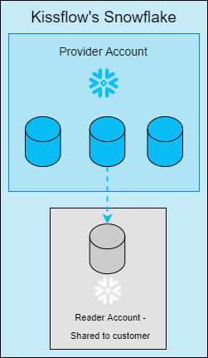
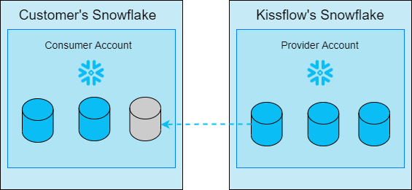
Data sharing to customers (external users)
READER ACCOUNT
FULL ACCOUNT

Slide 34
Demo – 2
Snowflake – Query semi-structured json data.
Power BI.

Slide 35
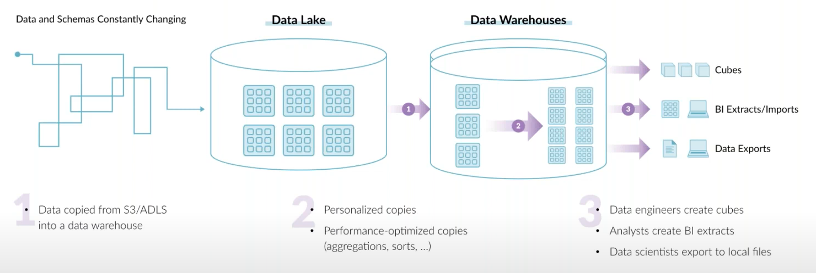
End goal of a data architecture
* Architect so that copying data gets lesser across teams.
* Choose (even its new) based on customers need, not based on what you or your team knows already.

Slide 36
What’s next
Data Lakehouse
Delta lake

Slide 37
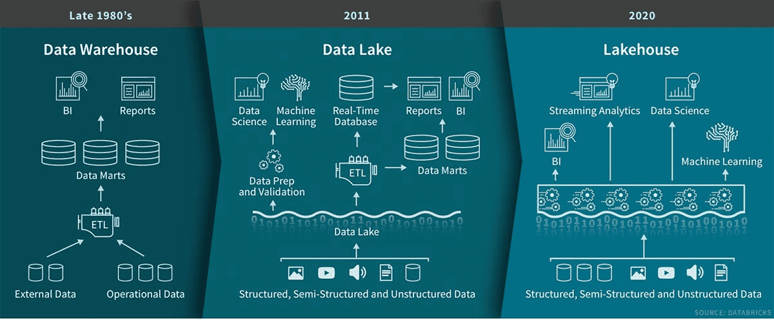
Data lakehouse

Slide 38
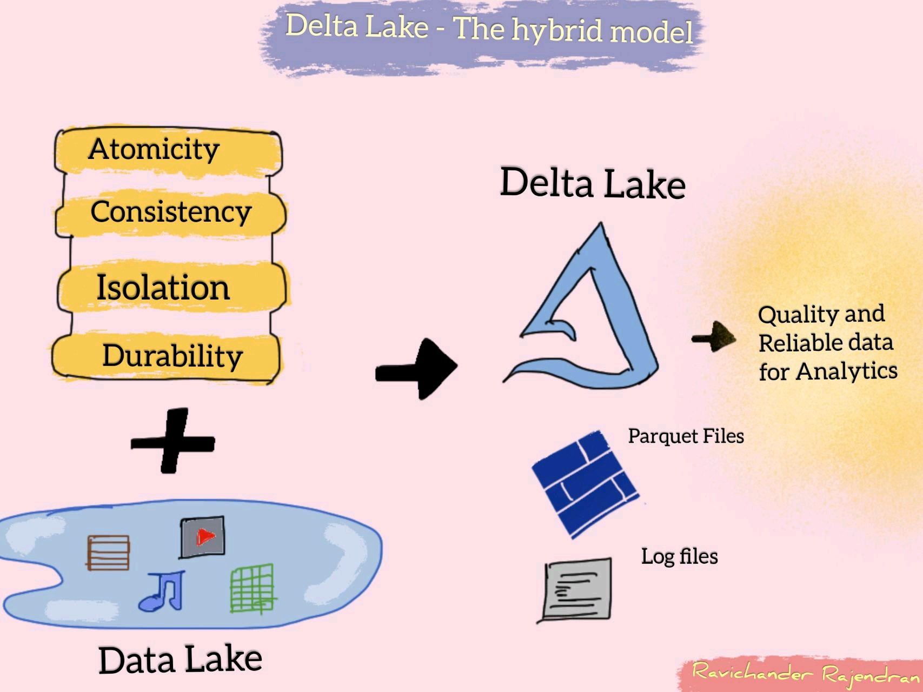

Delta lake – hybrid DATa format
Notes:
* Delta Lake that sits on top of data lake provides ACID transactions and unifies streaming and batch processing. It is also fully compatible with Spark APIs.
* In simple words, its about saving data as ‘Delta’ format and play with it.

Slide 39
Resources to dive deep
* Post about “What is Data Lakehouse?”
* Blog post by Ivana Pejeva.
* Debate with proponents of each architecture at Datanova 2021 hosted by Cindi Howson.
* Blog - Launching Databricks at If by Valdas Maksimavicius.
* Video about choosing Data warehouse and/or Data lake.

Slide 40
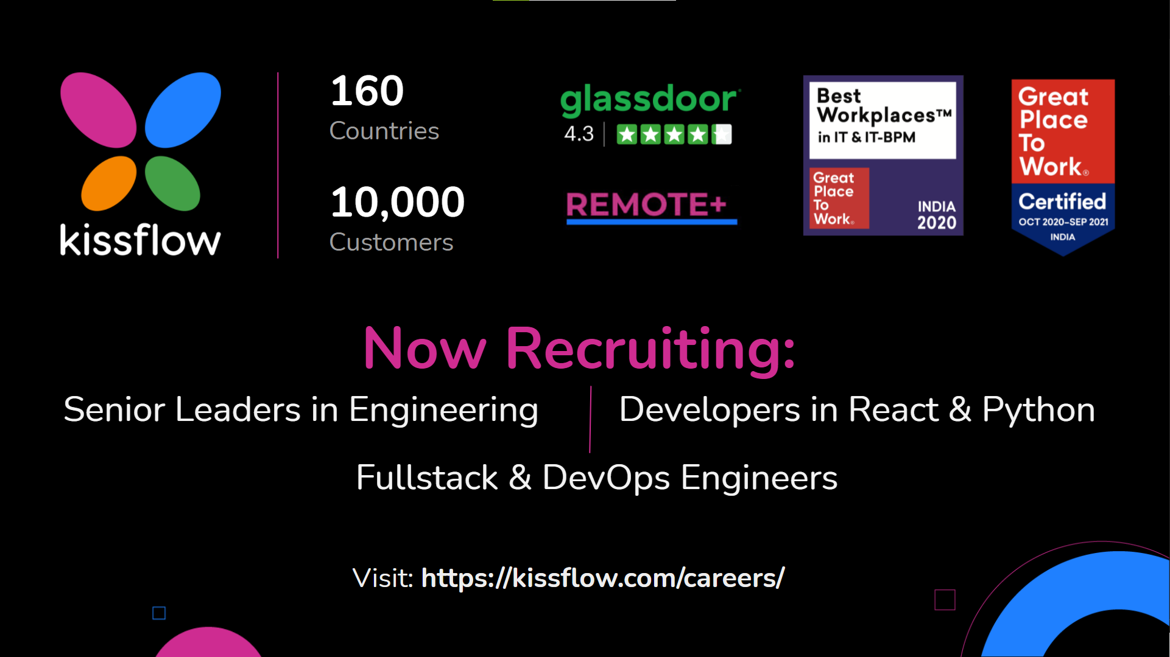

Slide 41

Questions ??
https://www.linkedin.com/in/dinesh-kumar-prabakaran

